Slide 1
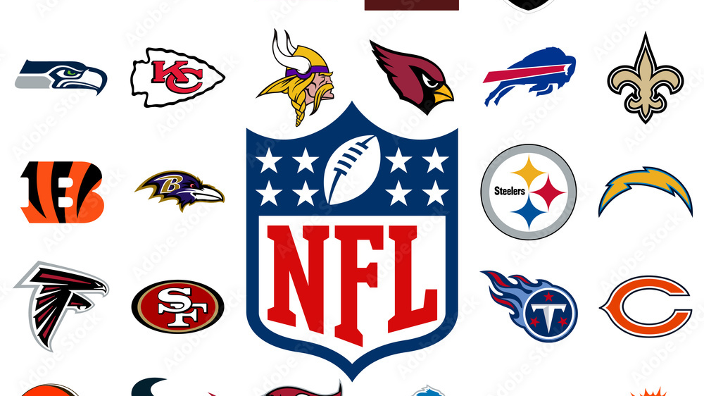
Analysis of ”Going for it” on fourth down 2022-2023 NFL Season
By: Jack Ross

Slide 2
Research Question
What is the strategical advantage of attempting an offensive play on fourth down to attempt to gain a first down?
To answer this question, I want to investigate:
What percentage of fourth downs were not punts or field goals in the 2022 NFL season?
Who were the top 10 most effective teams in terms of "going for it" on fourth down last year?
What was the average distance to go for a first down on all offensive fourth down plays last year?
What was the frequency of "going for it" on fourth down relative to each quarter of the game?
What was the team total success rate on attempted fourth down plays last season?

Slide 3
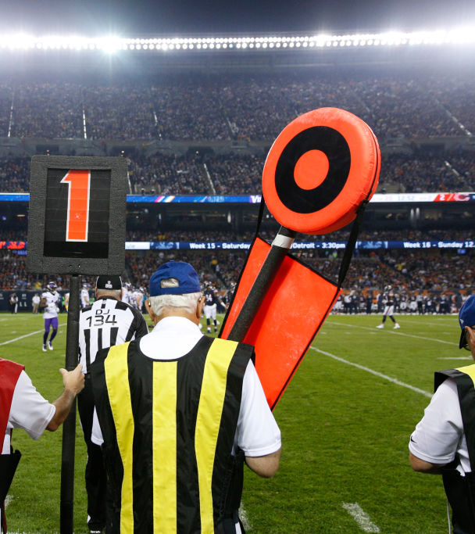
NFL Background Information
Football can be viewed as a game of possessions; each possession can only be continued if the possessing team gains ten or more yards within a four-play sequence
Each one of these plays is a ”down”
Teams often face a decision of what to do on fourth down, as this down can result in a loss of possession if the possessing team does not get a first down

Slide 4
Data Set
The NFL Plays data set contains 50,147 observations and 372 total variables for all the plays that were ran during the 2022-2023 NFL Regular and Post Season
The key variables I used for my analysis were down, rush.att, pass.att, posteam, ydstogo, yards_gained, qtr and play_type
By using these variables, I was able to collect more informational about the situational aspect of each one of the fourth down plays being considered from the data set

Slide 5
Exploratory Data Analysis
A “dummy variable” was created as a new variable in the data set. This variable was created by imposing a condition that made the outcome of the fourth down play either a zero or a one. A one indicates more yards were gained than the number of yards needed for a first down, a zero means not enough yards were gained for a first down.
The data set was filtered to only contain fourth down plays where a field goal, punt, quarterback kneel, or no play did not occur for most of my analysis
After filtering the data set to include the specified observations, I found the mean of the ydstogo variable to answer one of the research questions
The data set was also subset into Q1, Q2, Q3, and Q4 data sets, each one containing plays only from the first, second, third, or fourth quarter

Slide 6
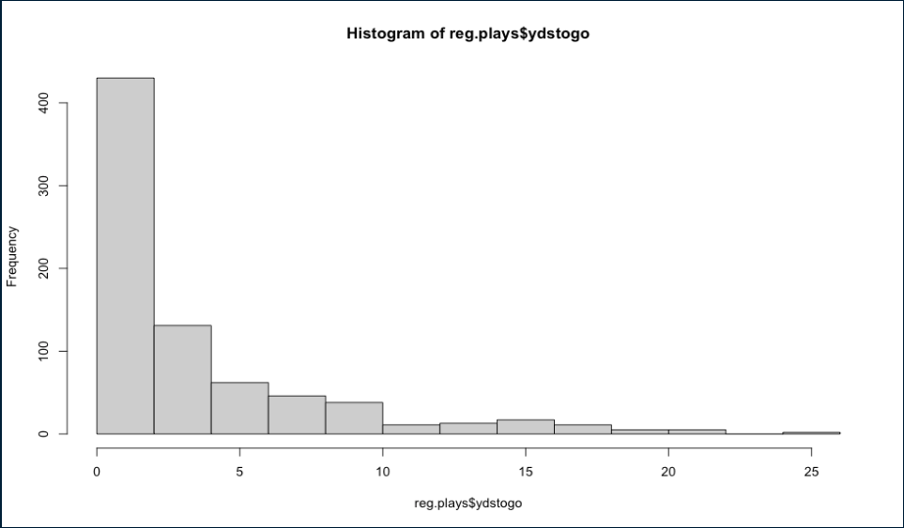
Exploratory Data Analysis
The variable ydstogo is very right skewed
This suggests that teams rarely go for it on fourth down when the distance is more than about five yards

Slide 7
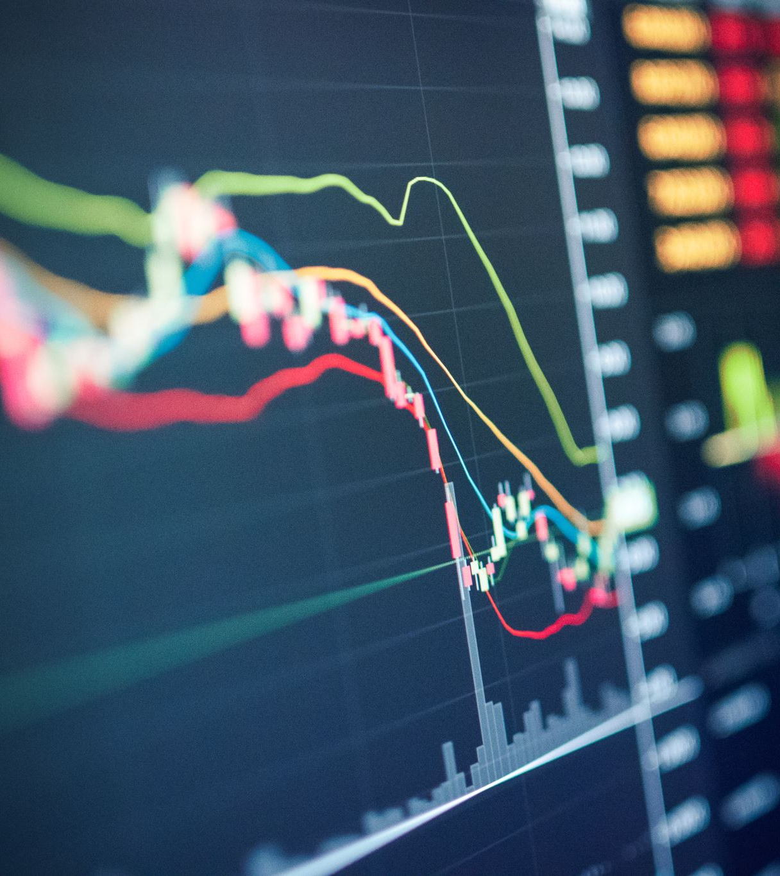
Statistical Techniques
Logistic regression was used to predict the contribution to the likelihood of a successful fourth down play from variables that were viewed as practically significant to the outcome of a fourth down play
Mean and standard deviation were used to analyze the ydstogo variable
Simple proportions were created within the R code used to analyze team’s success rates on fourth down

Slide 8

Results
What percentage of fourth downs were not punts or field goals in the 2022 NFL season?
What was the average distance to go for a first down on all offensive fourth down plays last year?

Slide 9
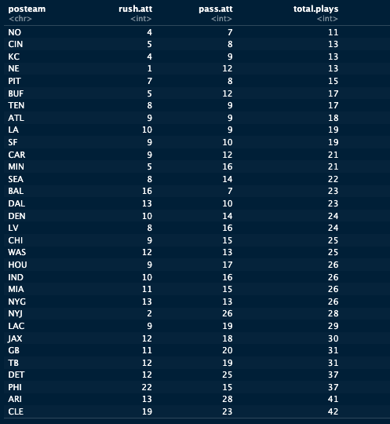
Results Frequency of rush and pass attempts on fourth down

Slide 10
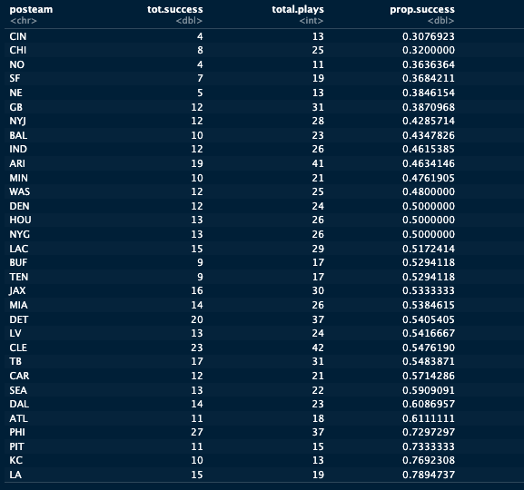
Results
Who were the top 10 most effective teams in terms of "going for it" on fourth down last year?
What was the team total success rate on attempted fourth down plays last season?

Slide 11
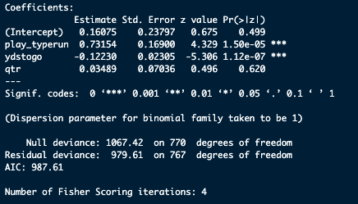
Results
What was the frequency of "going for it" on fourth down relative to each quarter of the game?
Logistic Regression Model Results

Slide 12
Conclusions
The strategical advantage when going for it on fourth down is strongest when a team can confidently run the ball given the distance required for a first down
Passing the ball on fourth down is substantially less effective than running the ball on fourth down
This is a function of yards needed for a first down, as the lesser yards need for a possessing team to get a first down intuitively increases the likelihood of the first down being converted successfully
The lesser yards needed also increases the chance of a running play, and this explains some of the inflated potency of running the ball on fourth down
It is also important to note the intangible aspects of coaching a football game such as experience and overall situational awareness, this is best demonstrated by the Chiefs and the Rams having the highest fourth down success rates last year, as Andy Reid and Sean McVay are considered as two of the best coaches in the NFL

Slide 13
Challenges/Future Work
One of the biggest challenges was effectively visualizing the output that was generated from the analysis
Also, it was challenging at first to understand how to classify a successful fourth down within the data set
In the future, I would like to further understand some of the dependent modeling techniques that can be used to better consider all the situational factors that build into a fourth down decision
Also, it would be interesting to conduct the same analysis at the end of this current season with the data from this season to compare to last season

